Slide 1
POWER BUSINESS
INTELLIGENCE
Tran Anh Tuan

Slide 2


POWER BI
Who? Hearing Research
What? Data Employee
Power PI Relationship - Video Demo

Slide 3
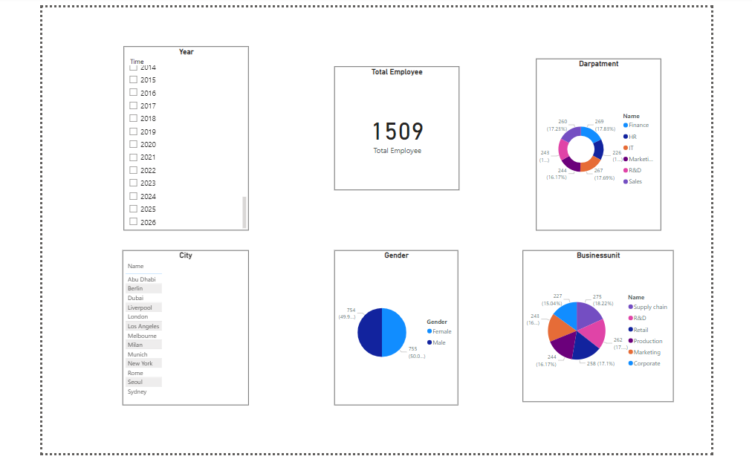
POWER BI - What?

Slide 4
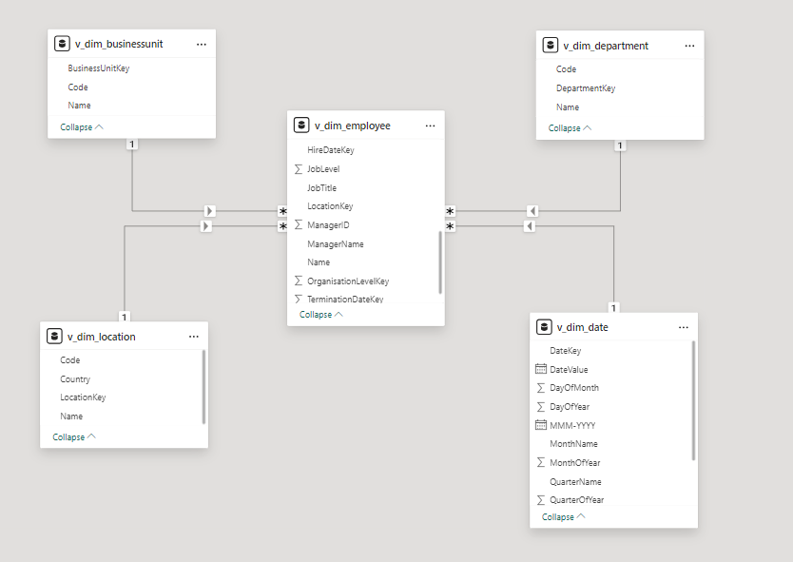
POWER BI - Relationship

Slide 5
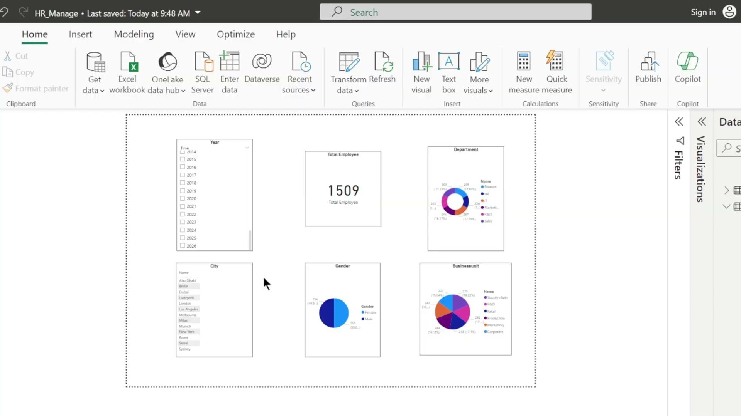
POWER BI - Video Demo
Link Video

